Slide 1
UMC Inclusion Training

Slide 2
What is Diversity?
Diversity is everything that makes us similar to and different from one another.
What is Inclusion?
Inclusion is when EVERYONE, regardless of who they are, feels welcomed and accepted.

Slide 3
Diversity and Inclusion at UMC Organization Mission
To enrich our culture at UMC by promoting inclusion and building on the strengths of everyone.

Slide 4
What’s in it for me?
Inclusive Environments
Encourage everyone to participate fully
Promotes full access to all opportunities
1. Pride in your work environment
2. Camaraderie amongst staff
3. Opportunities throughout the Organization

Slide 5
What’s in it for UMC?
High employee satisfaction
Improved patient care
Improved financial performance
Stronger relationships

Slide 6
UMCs Overall Goal
Increase our own awareness in how we think about and how we treat people.
To create productive and respectful relationships with all co-workers and customers, whether we think they are similar or different than ourselves.

Slide 7
UMC Gender-Age Group
2015 2016 2017
20-29 34% 34% 34%
30-39 26% 26% 26%
40-49 18% 18% 18%
50+ 21% 21% 21%
Under 20 1% 1% 1%
Male 27.5% 28.0% 28.0%
Female 72.5% 72.0% 72.0%

Slide 8
UMC Ethnicity
2015 2016 2017
Asian/Islander 1.3% 1.2% 1.2%
Hispanic 29.0% 32.0% 32.0%
Native American 0.4% 0.3% 0.3%
African American 5.8% 6.0% 6.0%
White 55.0% 53.0% 52.0%
Asian 5.5% 5.0% 5.3%
Not Disclosed 3.0% 1.5% 2.0%
Multi* 0.0% 1.0% 1.2%
Started tracking multi ethnicity in 2016

Slide 9
UMC Patient Gender-Age
2011 2012 2013
0-18 18% 18% 17%
19-29 20% 20% 20%
30-39 13% 14% 14%
40-49 13% 13% 13%
50-64 19% 19% 20%
65+ 16% 16% 16%
Male 45% 45% 45%
Female 55% 55% 55%

Slide 10
UMC Patient Ethnicity
2011 2012 2013
White 45% 45% 46%
Hispanic 30% 30% 28%
Black 12% 12% 12%
Other 13% 13% 14%

Slide 11
What is culture?
A way of life of a given society, passed down from one generation to the next through learning and experience.
Organizational Culture
A collective behavior formed by values, visions, norms, and systems that include beliefs and habits.

Slide 12
Culture Is:
The way of life for a group of people; every group develops its own culture over time.
A set of rules both written and unwritten, by which people live.
We are often not aware of the influence of our own culture until we leave it and become immersed in another culture.
Culture is learned.
Culture is complex.

Slide 13
Appreciating Different Cultures
UMC has become more diverse and better understanding and acceptance of different cultures is important to the success of our organization.
Stereotypes
Creating an inclusive workplace requires increasing our own awareness of stereotyping and CHOOSING NOT TO ACT ON OUR STEREOTYPES.

Slide 14
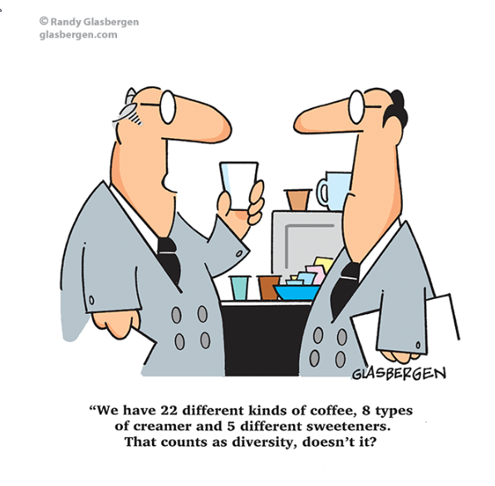
What is Stereotyping?
A stereotype is usually an idea or assumption that a person has about an entire group, and therefore, to any individual that may belong to that group, often relating to gender, age, ethnicity, physical appearance, or characteristics that can be grouped together. They are usually negative and offensive.

Slide 15
Common Stereotypes
Teenagers are lazy.
All Asian-Americans are good in math.
You know how women are.
She’s a dumb blonde.
He’s really sensitive for a man.
You’re not like other Jewish people.
Old people shouldn’t behave like that.
Brazilians are rude and pushy.
Americans are shallow.
Sam, what do gay men think about this?
He’s Muslim so he must be a terrorist.

Slide 16
Steps to Move Past Stereotypes
Acknowledge that they exist.
Identify any that you’ve internalized; recognize stereotypical thoughts when they occur.
Pause and take a second look.
Remove judgment; describe behavior.
Learn more about the individual or group being stereotyped; choose behavior that enhances relationships.

Slide 17
Inclusive Environment
We all have a role in building an inclusive environment. Creating a
respectful, productive workplace depends upon your commitment
and involvement.
Its up to each of us to increase our knowledge and recognize the
value of the different cultures here at UMC.
Diversity and Inclusive Culture
Our goal is to foster productive and respectful relationships with
all UMC co-workers and customers, whether we perceive them
as similar to or different than ourselves.

Slide 18
Human Resources
Documented completion of staff orientation specific to sensitivity to cultural diversity based on their jobs, duties and responsibilities.
Staff education to P&PS specific to patient communication and cultural health beliefs P&Ps.
Qualifications for language interpreters may be met through language proficiency assessment, education, training and experience. Untrained individuals including family members, friends, other patients or untrained bilingual staff should not be used.

Slide 19
Provision of Care Treatment and Services
End of life care – information on social, spiritual and cultural
variables that influence the patient’s and family members’
perception of grief are gathered during initial assessment.
Food and Nutrition – when possible, the hospital accommodates
the patient’s cultural, religious or ethnic food and nutrition
preferences unless contraindicated.
Patient Education – a learning needs assessment provided to
patients based on individual abilities including cultural and
religious beliefs, emotional barriers, desire and motivation to
learn, physical or cognitive limitations and communication barriers.

Slide 20
Individual Rights and Responsibilities
The hospital respects and protects cultural and personal values,
beliefs and preferences and accommodates patients’ rights to
religious and other spiritual services.
The hospital provides interpreting services as necessary
The hospital communicates with the patient who has vision,
speech, hearing or cognitive impairments in a manner that
meets the patients’ needs.

Slide 21
Individual Rights and Responsibilities
The hospital allows a family member, friend or other individual
to be present with the patient for emotional support during the
course of the stay.
The hospital prohibits discrimination against age, race, ethnicity,
religion, culture, language, physical or mental disability,
socioeconomic status, sex, sexual orientation and gender
identity or expression.

Slide 22
UMCINCLUDESME.COM

